Slide 1
K-Nearest Neighbor (KNN) Algorithm in Machine Learning
By Ms. Priti P. Jorvekar

Slide 2
Introduction
This algorithm works for both classification and regression problems
KNN is a reasonably simple classification technique that identifies the class in which a sample belongs by measuring its similarity with other nearby points.
it is a powerful technique for identifying the class of an unknown sample point.
It classifies the data point on how its neighbor is classified.

Slide 3
How does K-Nearest Neighbours Work?
The steps for the KNN Algorithm in Machine Learning are as follows:
Step 1: The optimal value of K is determined.
Step 2: The KNN algorithm calculates the distance of all data points from the query data point using the distance measuring techniques stated above.
Step 3: It ranks the data points by increasing distance. The closest K points in the data space of the query point are its nearest neighbors.
Step 4: For each query point, one of these K neighbors predicts its class .
Counting the data points in each category and taking the majority votes into consideration – KNN Classifier model.

Slide 4
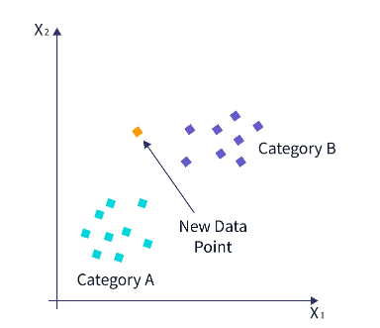
Working
Suppose we have a new data point and need to put it in the required category. Consider the below image :

Slide 5
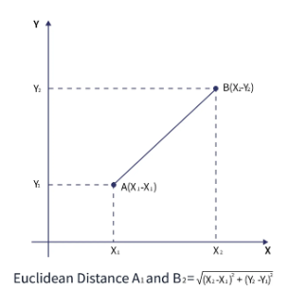
First, we will choose the number of neighbors as k=5.
Next, we will calculate the Euclidean distance between the data points. The Euclidean distance is the distance between two points, which we have studied in geometry. It can be calculated as :

Slide 6
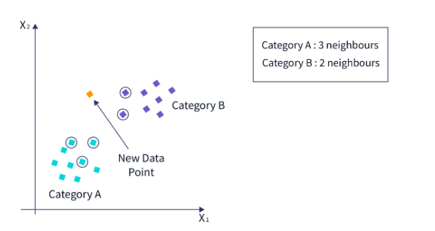
By calculating the Euclidean distance, we got the nearest neighbors, as three nearest neighbors in category A and two nearest neighbors in category B. Consider the below image :
As we can see, the three nearest neighbors are from category A. Hence this new data point must belong to category A.
A KNN classifier determines the class of a data point through a majority vote of nearest neighbors

Slide 7
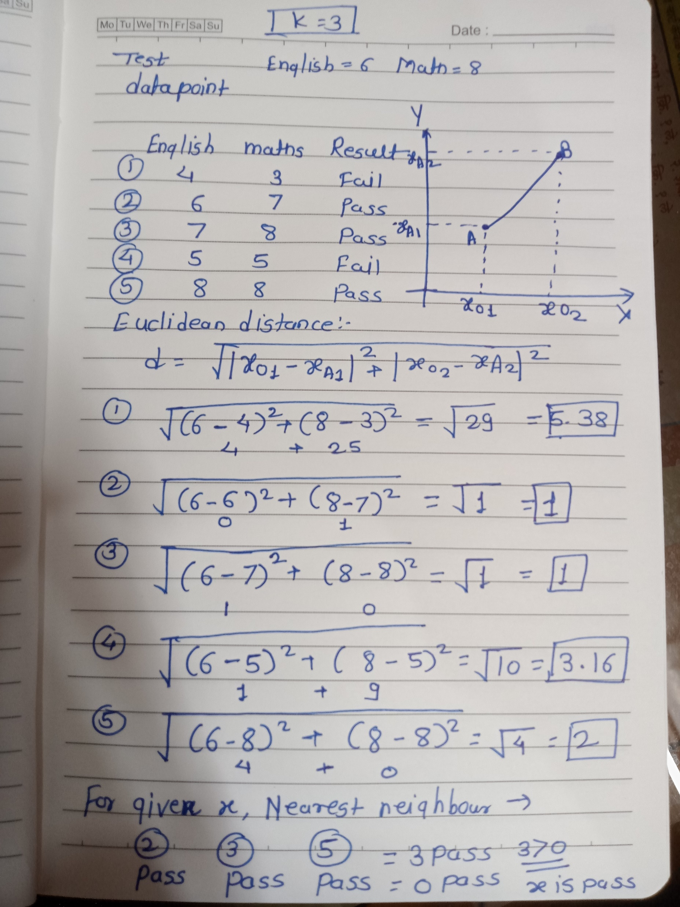

Slide 8
Types of Distance Metric
The decisions made by KNN depend on the type of Distance Metric we have chosen. A distance metric is a quantified measure of how 'far' or 'close' two points are. Apart from Euclidean Distance, Manhattan, Minkowski, and Hamming Distances can be used as distance metrics for KNN.

Slide 9
How to Determine the K Value ?
Choosing an appropriate value of k in KNN is crucial to get the best out of the model.
If the value of K is small, the model's error rate will be large, especially for new data points, since the number of votes is small. Hence, the model is overfitted and highly sensitive to noise in the input. Moreover, the boundaries for classification become too rigid,
On the other hand, if the value of K is large, the model's boundaries become loose, and the number of misclassifications increases. In this case, the model is said to be underfitted.

Slide 10
Methods to find K
There is no fixed method to find k, but the following points might help :
Set K as an odd number, so we have an extra point to settle tie-breakers in extreme cases.
Square Root Method: We can consider the square root of all data points in the training dataset as the optimal value of K.

Slide 11
Advantages of the KNN Algorithm in Machine Learning
KNN is extremely useful in scenarios that require high accuracy and do not contain many unknown points to classify. The concept of learning does not apply to KNN. Hence, if we need a quick prediction for a limited number of data points, then KNN is the go-to algorithm since other models, like neural networks and logistic regression, require time for training.
Easy to implement
Simple hyperparameter tuning

Slide 12
Disadvantages of the KNN Algorithm in Machine Learning
KNN will confidently classify data points far beyond the dataset's actual scope.
KNN is sensitive to noise, so accurate data preprocessing must be done.
KNN employs instance-based learning and is a lazy algorithm that refers to an algorithm that does not learn anything from the dataset. Each time a new data point is supplied, it calculates the distance between that point and all other points in the dataset, which is computationally expensive. Essentially, the idea of training the KNN model does not exist because it makes a new decision by calculating the distances from a new point.
For large datasets, the program needs to be memory-optimized, else it will take too much memory to perform classification. There are many workarounds for many of these disadvantages, which makes KNN a powerful classification tool. For example, we can apply the Weighted KNN algorithm to improve the accuracy.

